Slide 1
Project Progress Report
DOT Traffic Ops database migration project
Jason Wu, Hyunsoo Lee

Slide 2
Background, Goals, Objectives
Background: The current database that NYC DOT Traffic Ops is using to store relevant information on crossing signals is slow to respond to input, takes up excessive and redundant storage, is user unfriendly, and requires dedicated maintenance.
This project intends to resolve this problem by creating a new database and User Interface that will replace the existing database and UI and port over all existing data.

Slide 3
Updates
We have received a copy of the database from Bill. Hyun Soo has migrated the database file to our existing back-end.
We have created development environments for the back-end server and front-end UI. Hyun Soo has started implementing some features to both ends (such as the interactive map and data point markers).

Slide 4
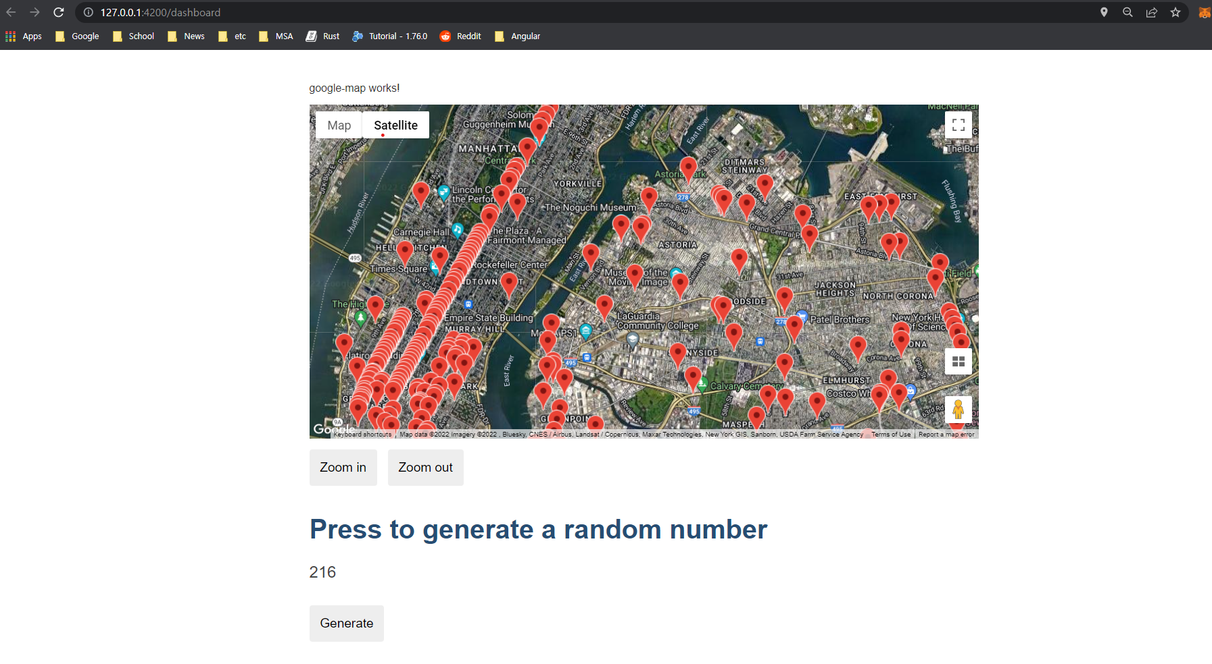
Screenshots

Slide 5
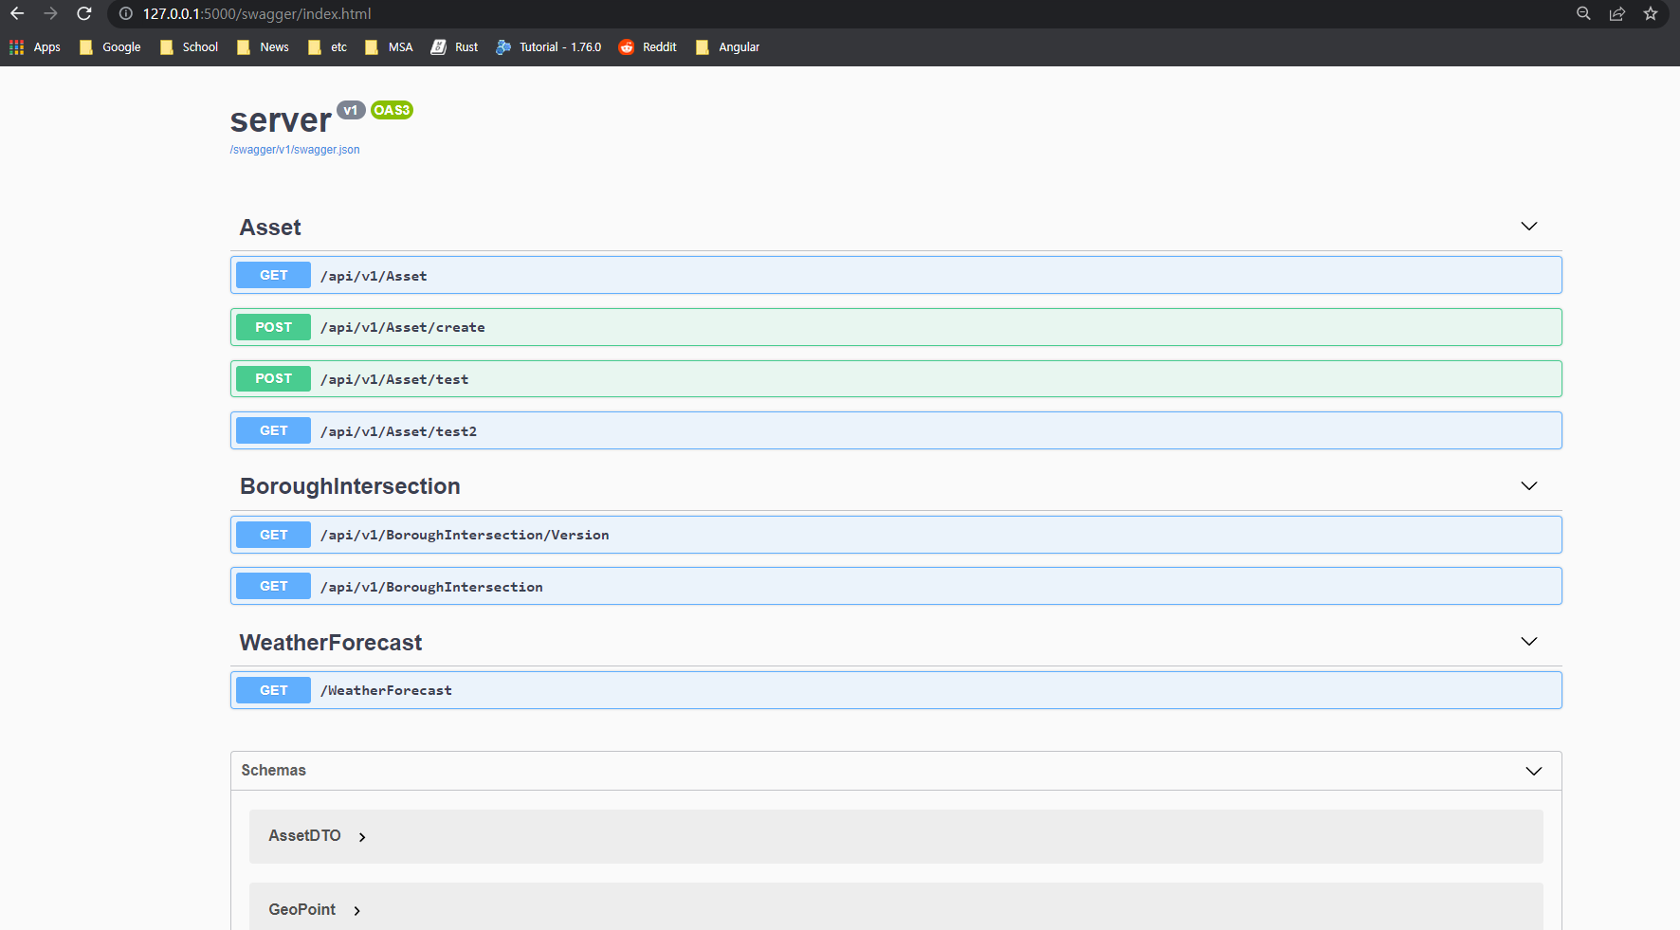
Screenshots

Slide 6
Process
We are currently in the first section (front and back ends).
User Interface
Database and server
Ensure functional UI
Ensure responsive database
Clean data from old database
Parse data to new database
Front and back ends
Testing
Data migration

Slide 7
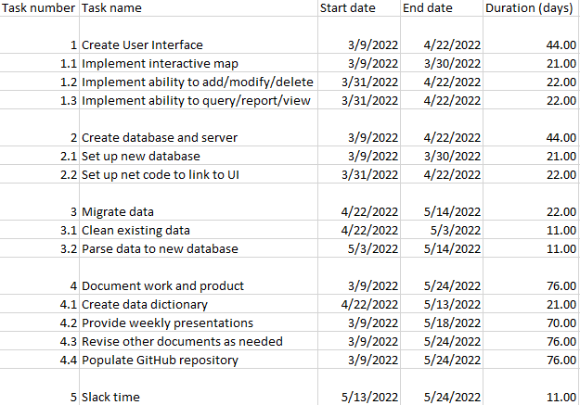
Current work breakdown

Slide 8
Communication Plan
Name | Title | Frequency | Format, Channel | Notes
Maddalena Romano | Sponsor, Stakeholder | Weekly | Presentations via Zoom, other issues via email
Bill Harrison | Stakeholder | Asynchronous | Presentations via Zoom if present, other issues via email as needed
Type | Method | Frequency | Goal | Owner | Audience
Progress Report | Presentation via Zoom | Weekly, every Wednesday | Inform audience of the state of the project as of each report | Project Managers | Stakeholders, Customers

Slide 9
Questions, contact
Contact info (Jason Wu):
(347)274-4302, zehong.wu@macaulay.cuny.edu
Contact info (Hyunsoo Lee):
hsleenet@gmail.com

